Slide 1
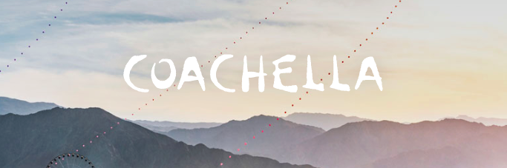
Coachella
The Coachella Valley Music and Arts Festival is an annual music and arts festival held at the Empire Polo Club in Indio, California, located in the Inland Empire's Coachella Valley in the Colorado Desert.

Slide 2
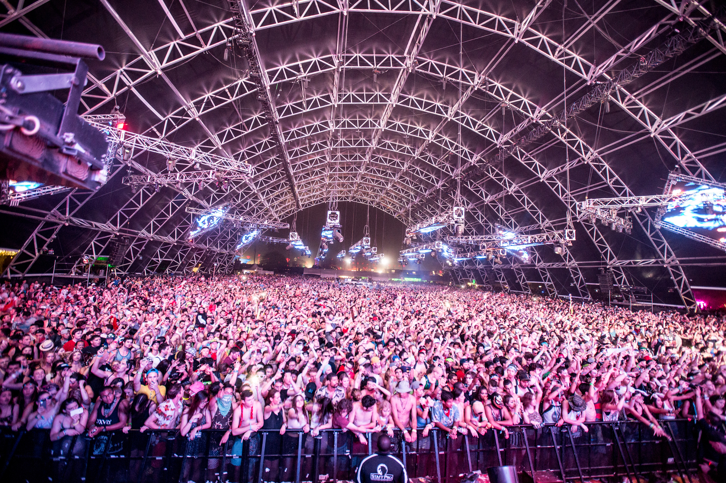
Audience
In 2016, Coachella drew 99,000 attendees each day of the six-day festival

Slide 3
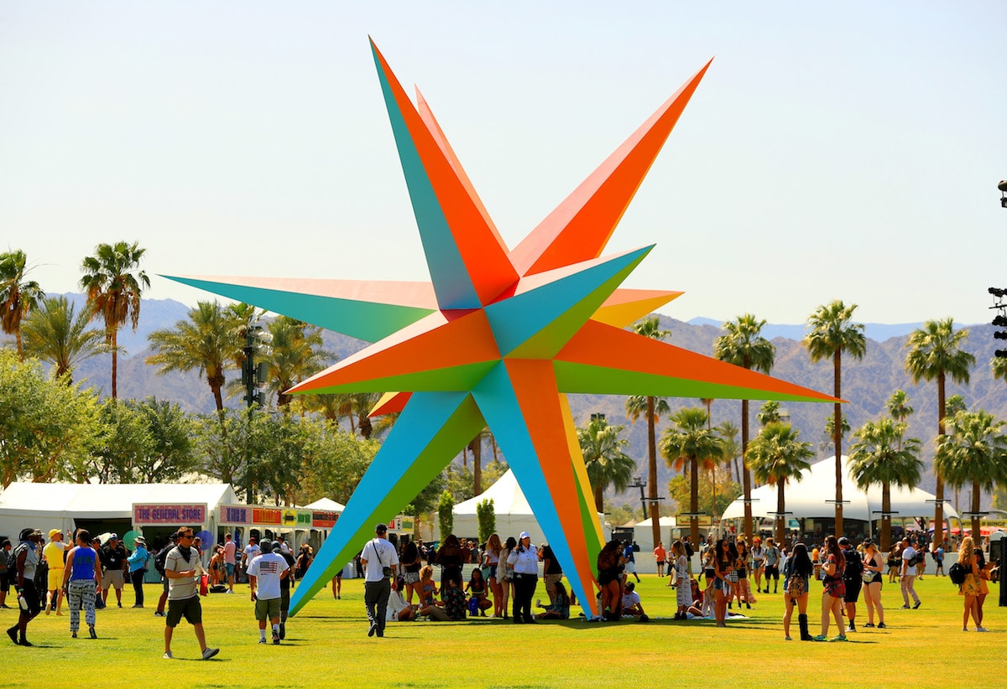
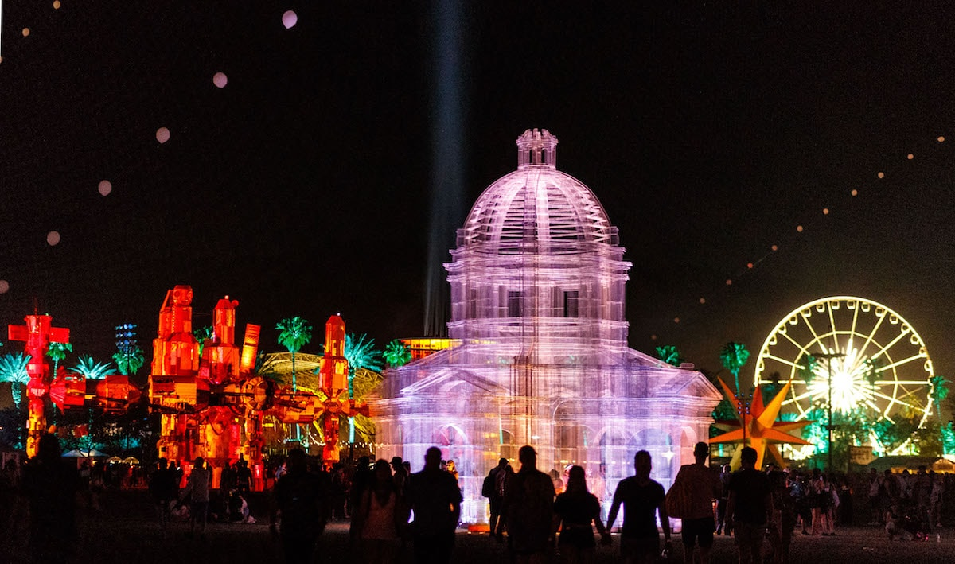
Context
There are typically 10-15 large-scale art installations every year
Installations are known to evolve from day to night

Slide 4
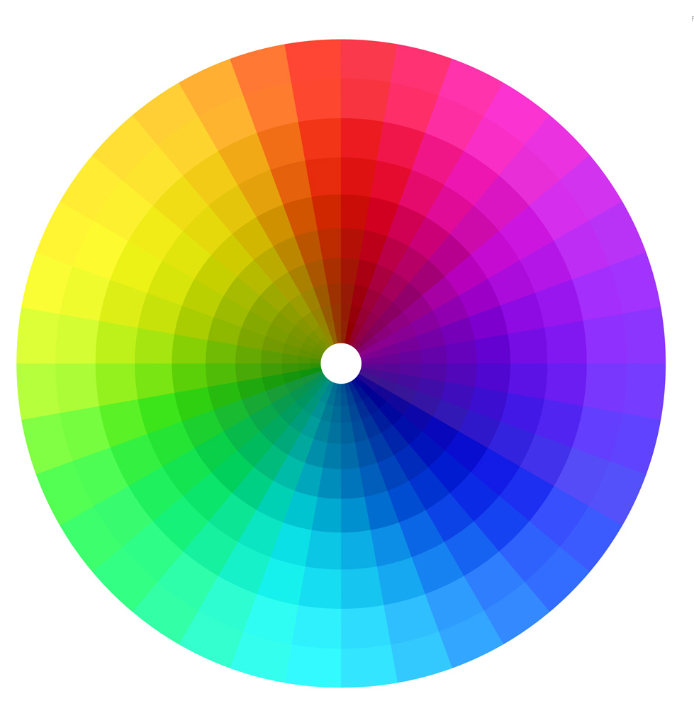
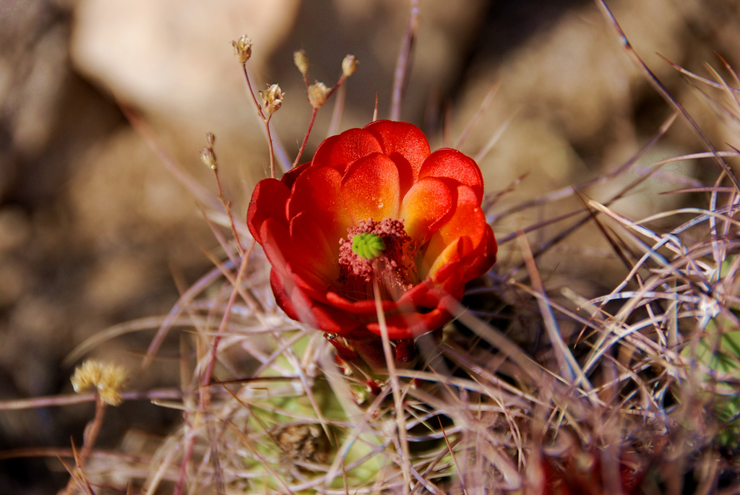
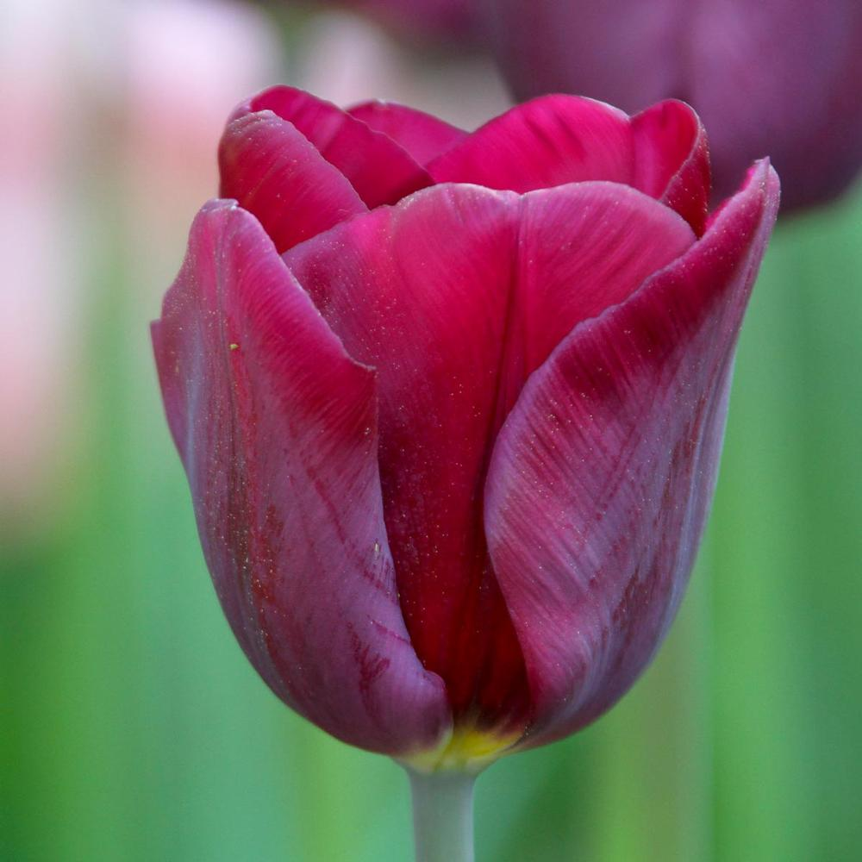
Inspiration
Nature, projection, color spectrum, size
“Desert Flower”
Each “petal” can be a surface on which to project

Slide 5
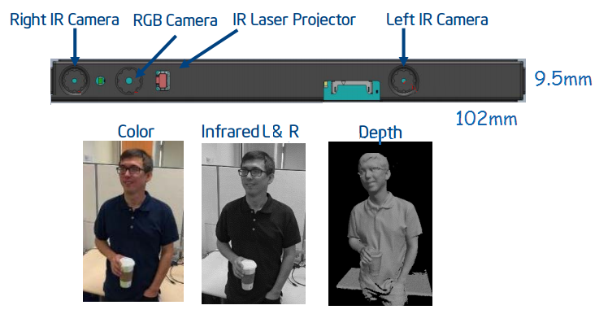
Ideation
The goal is to have the installation to be “secretly” interactive
Depth camera captures movements and reacts in a subtle way
Ideal experience is to have a revelation that the exhibit is interactive

Slide 6
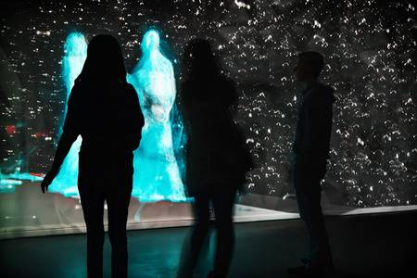
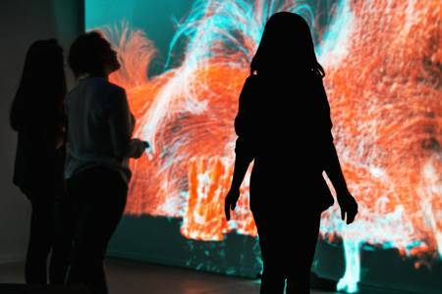
Ideation

Slide 7
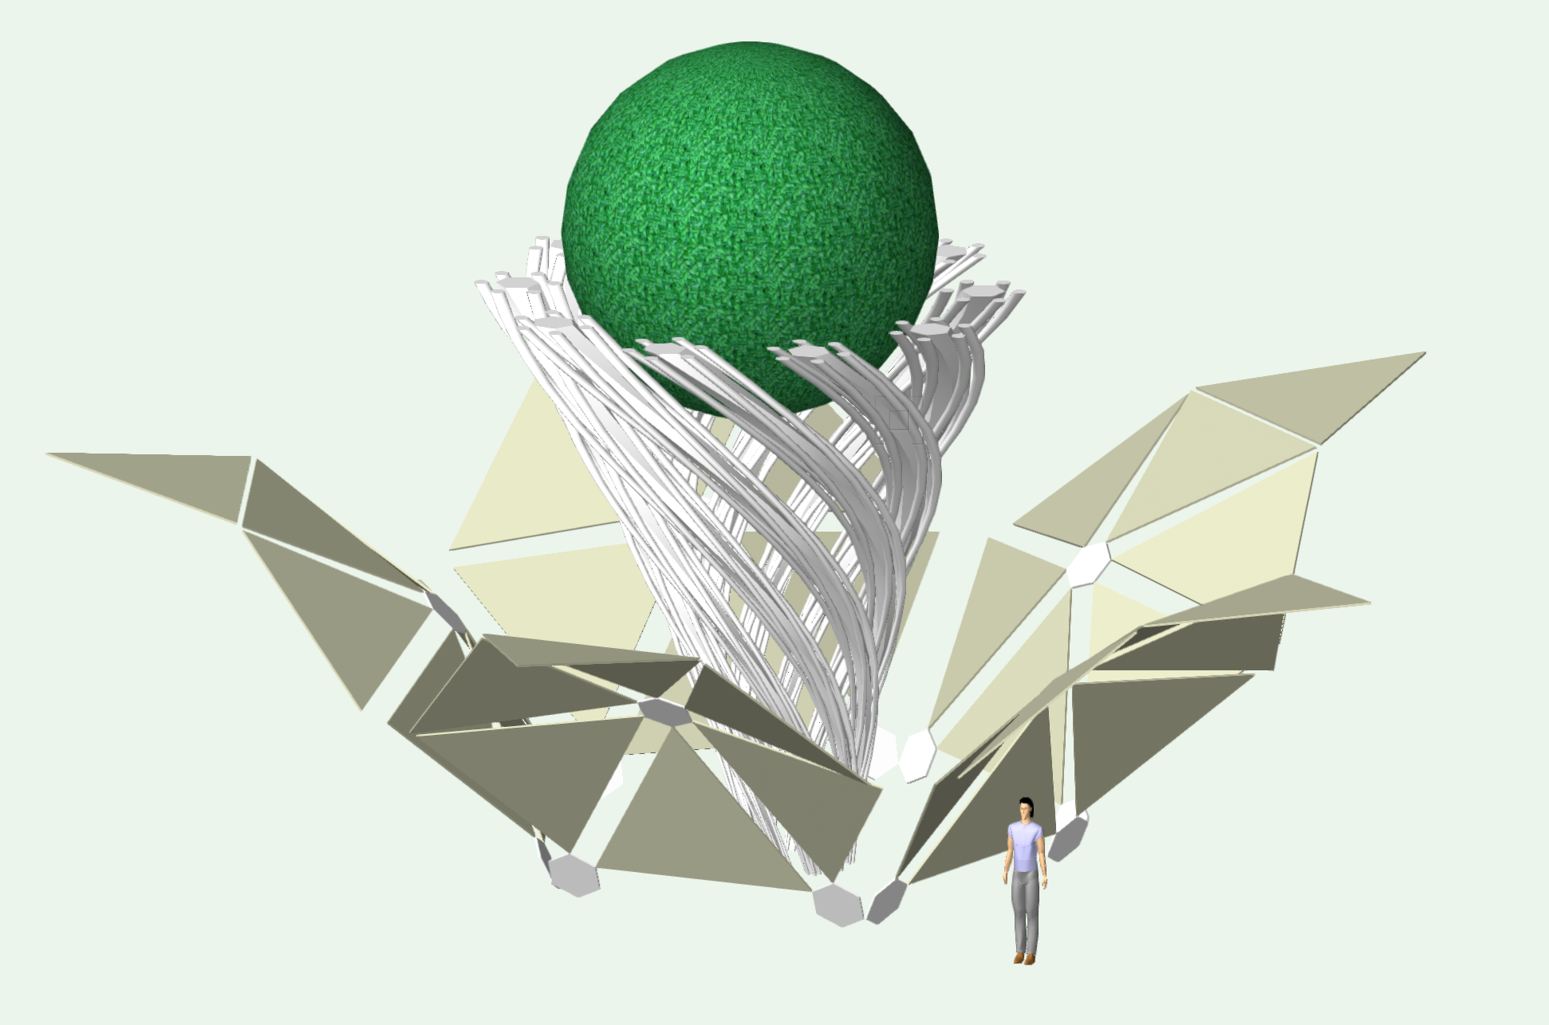
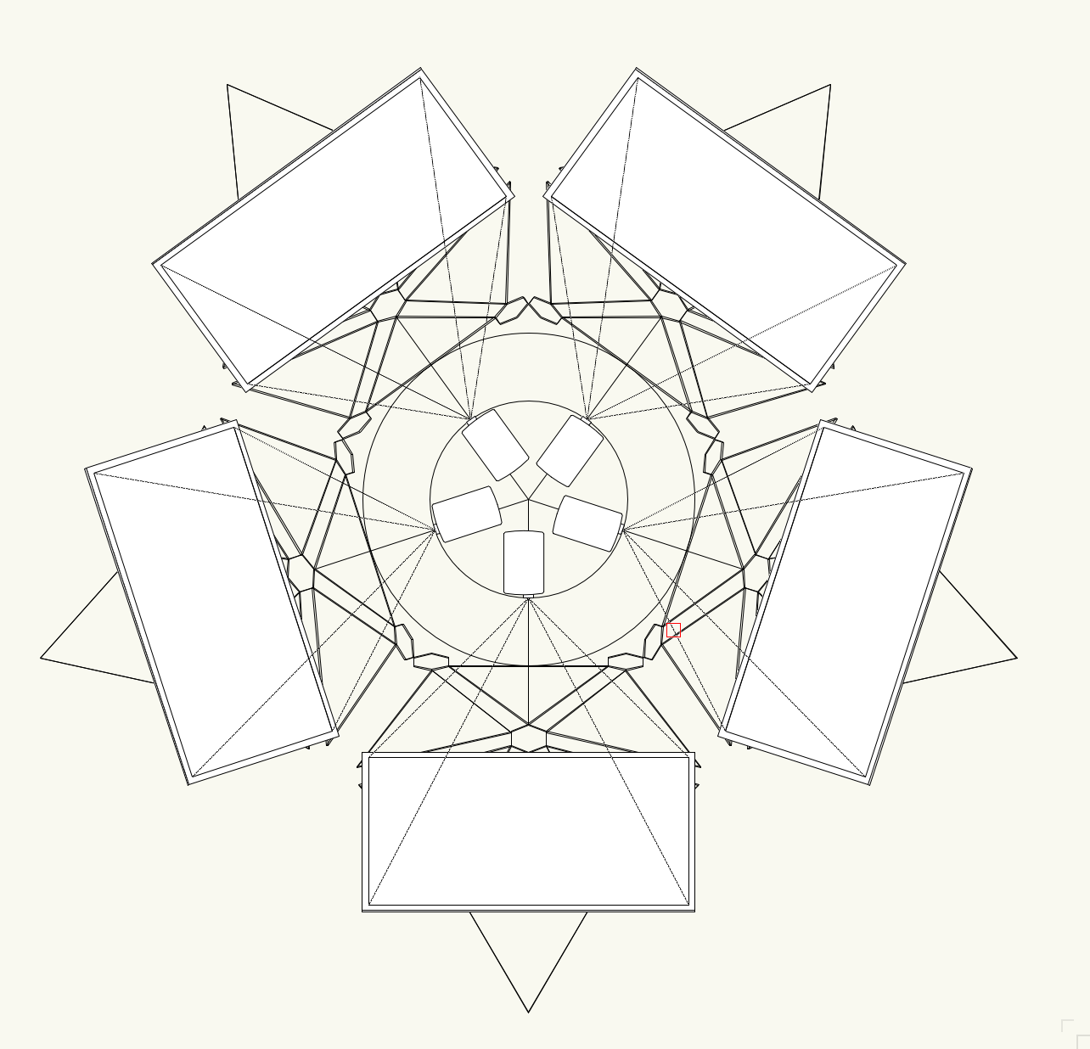

Slide 8
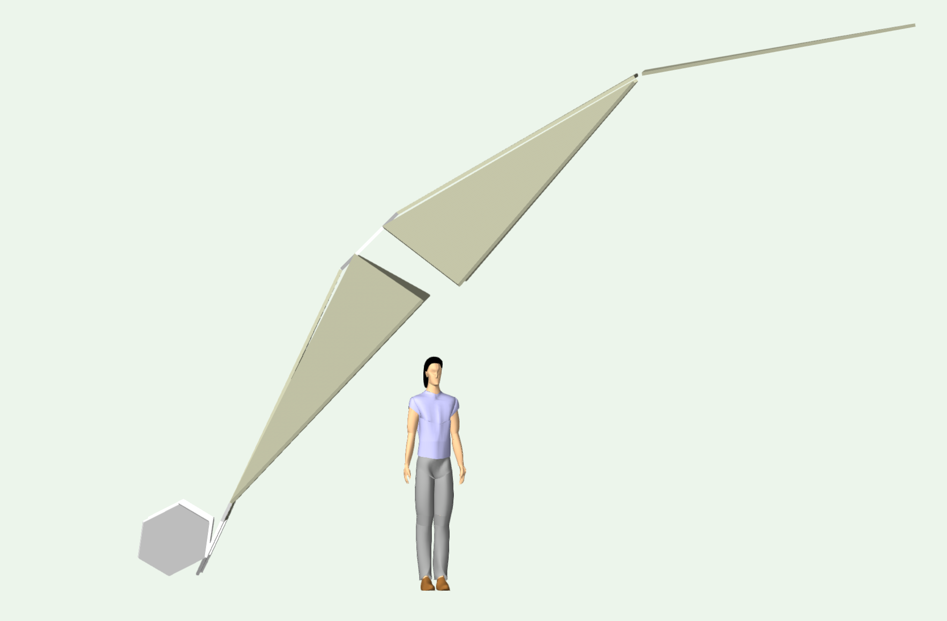
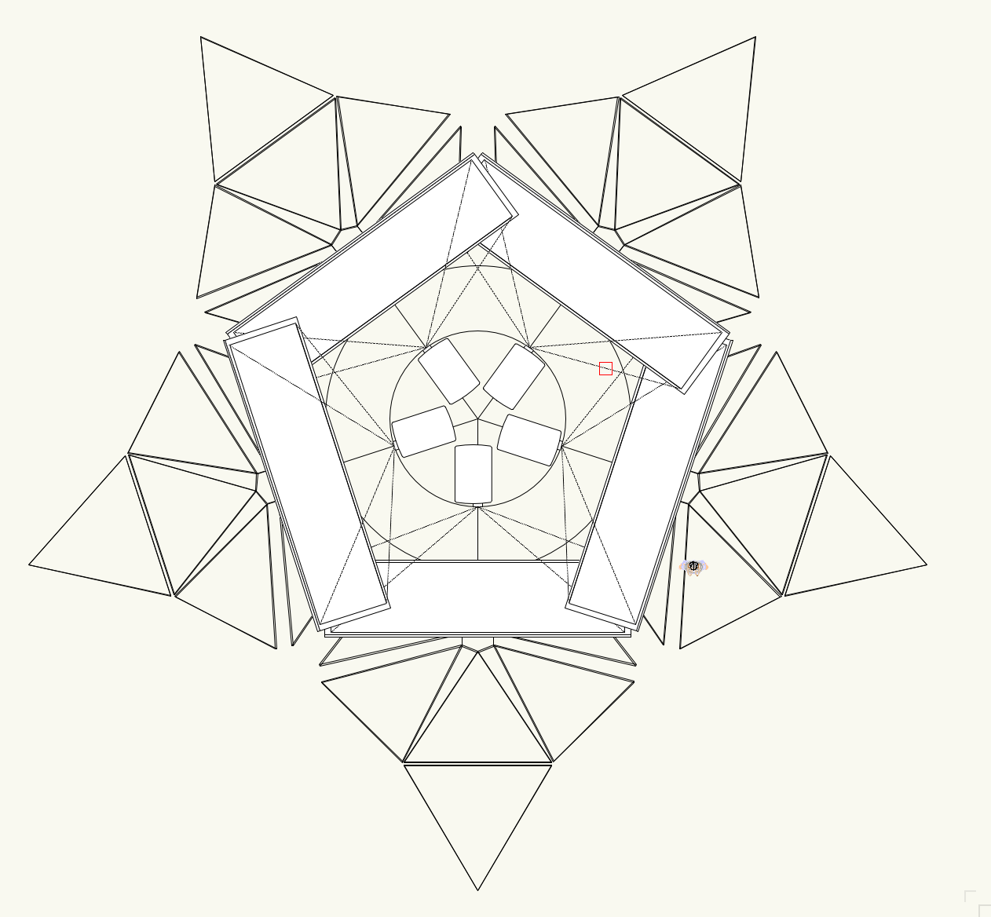

Slide 9
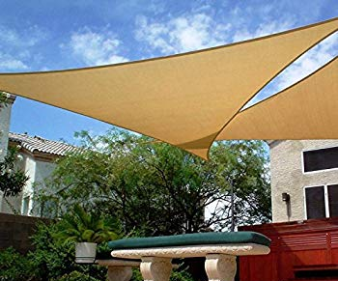
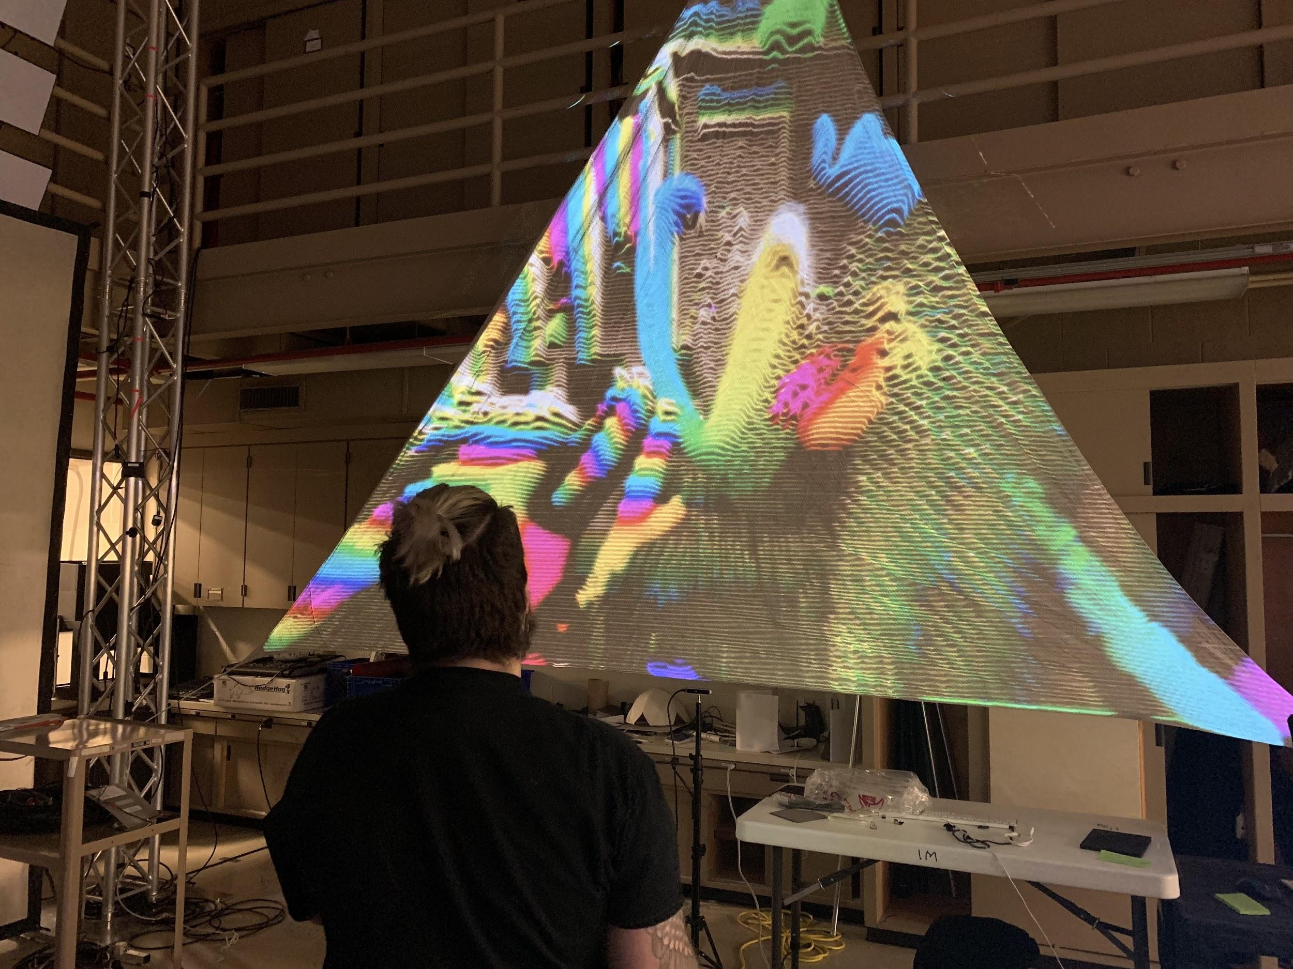
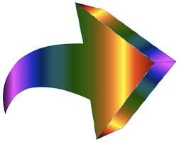
User Experience
Initially, user doesn’t know exhibit is interactive
User walks up to tarps for shade during the day
At night, projections are easier to make out to be interactive

Slide 10
User Experience
User can “draw” on the surface by using phone flashlight
The act of users interacting with installation will interest and attract nearby festival goers

Slide 11
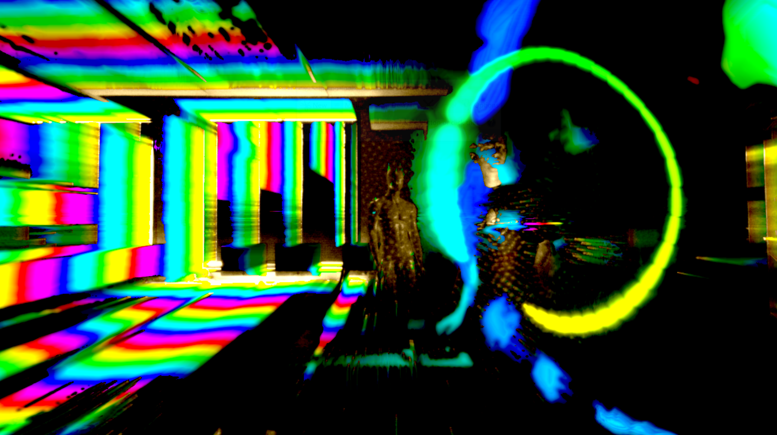

Slide 12
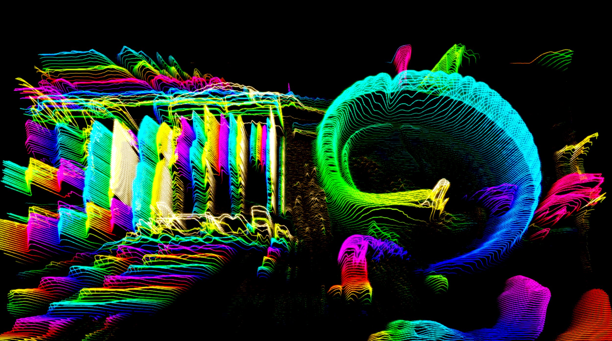
Project Visualizations

Slide 13
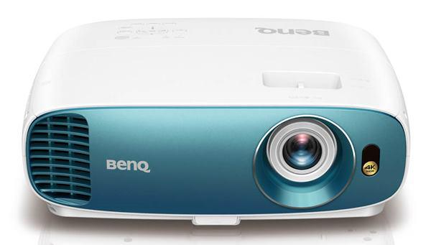
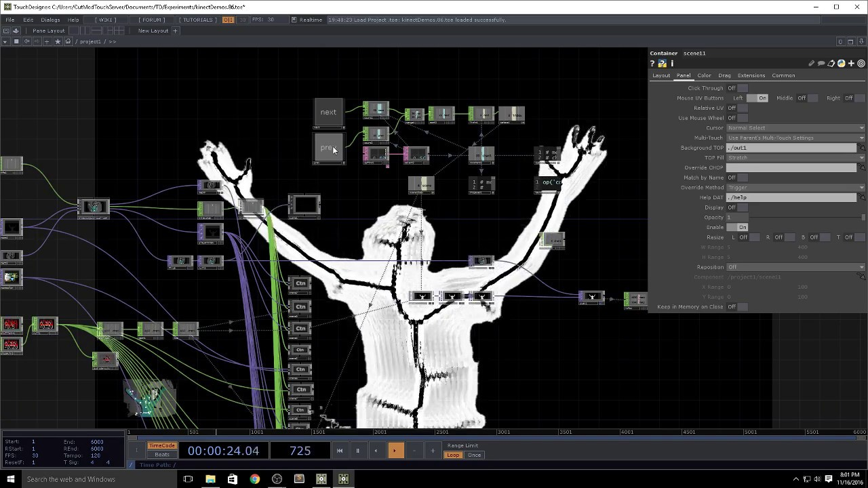

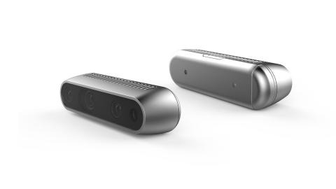
Creative Technologies
Depth/Infrared Sensors
TouchDesigner
Projection Design

Slide 14
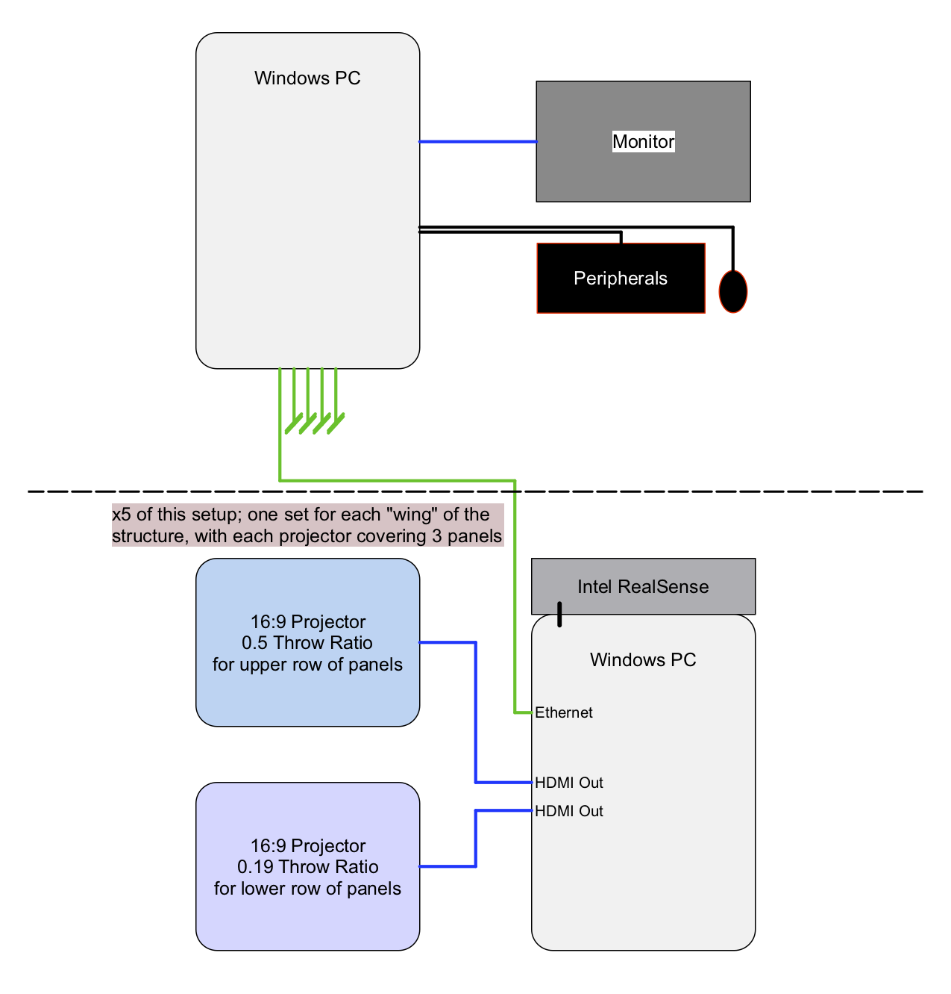
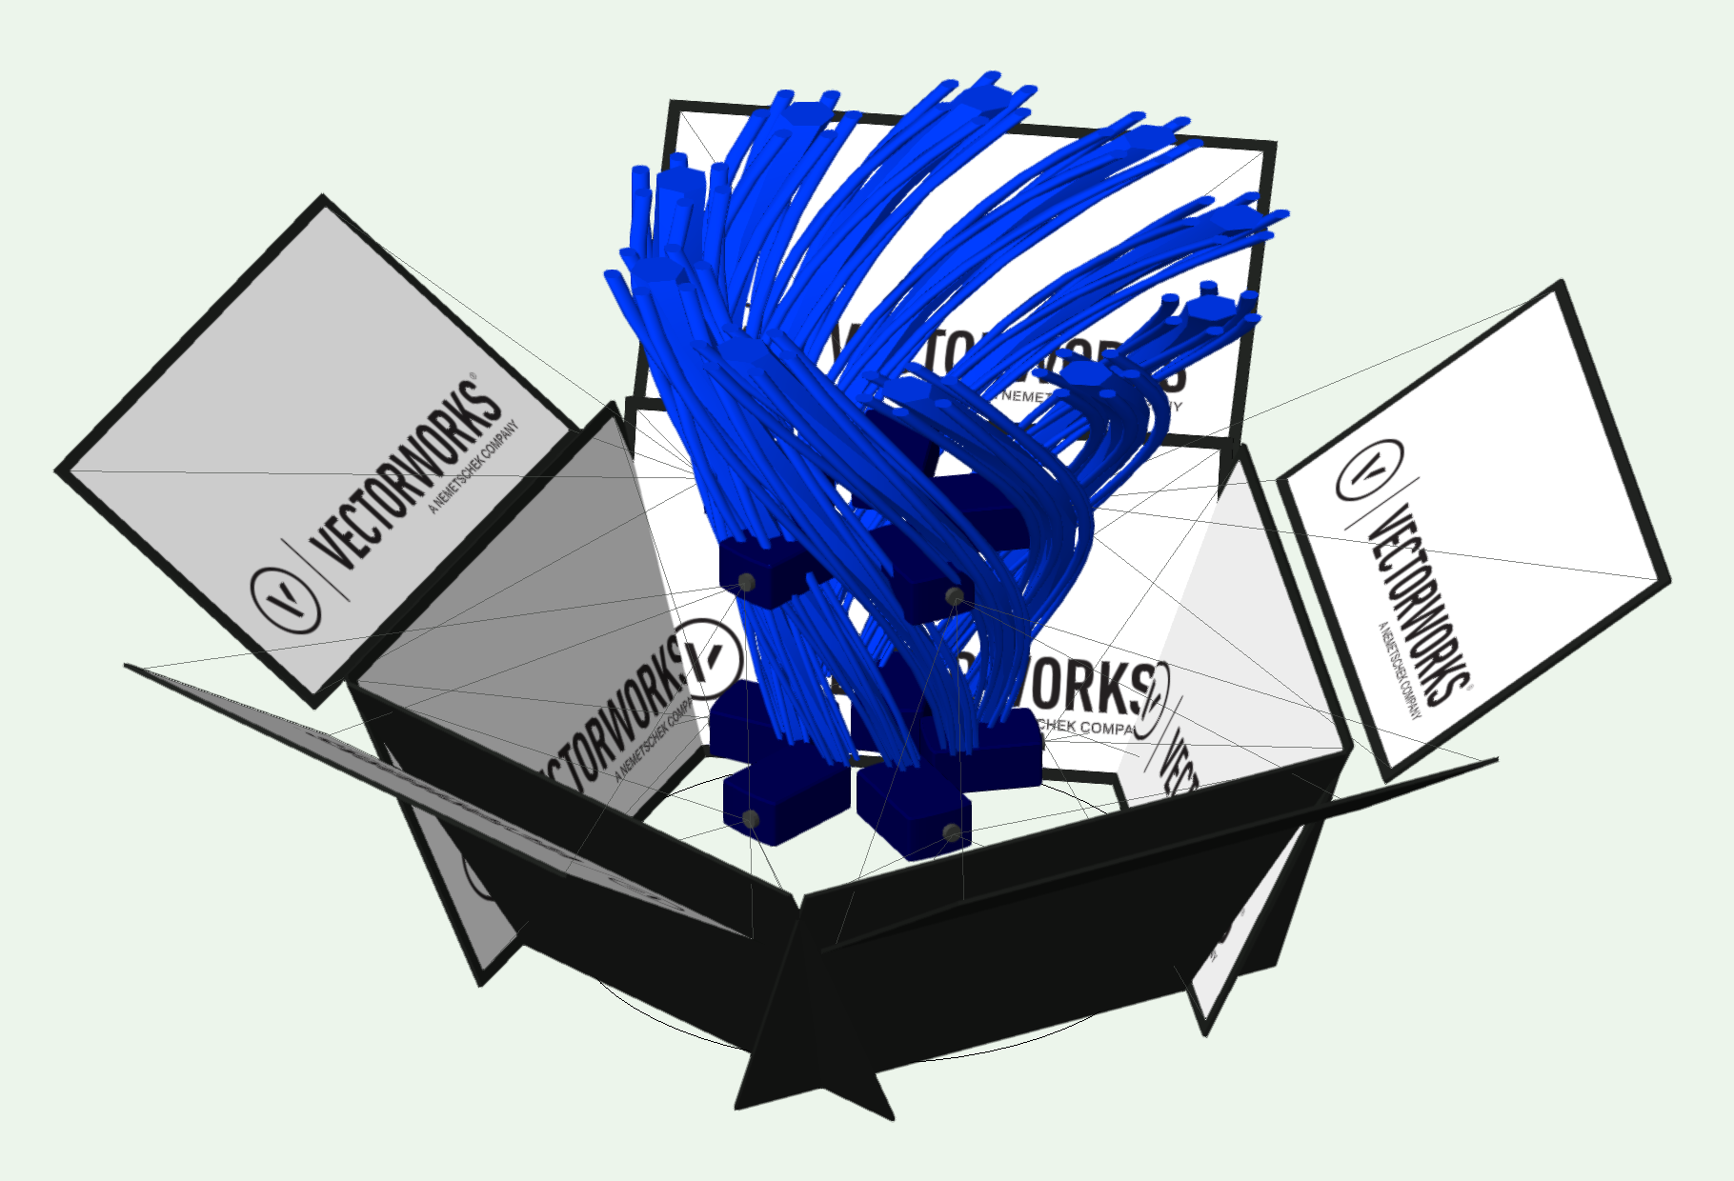
System Diagram

Slide 15
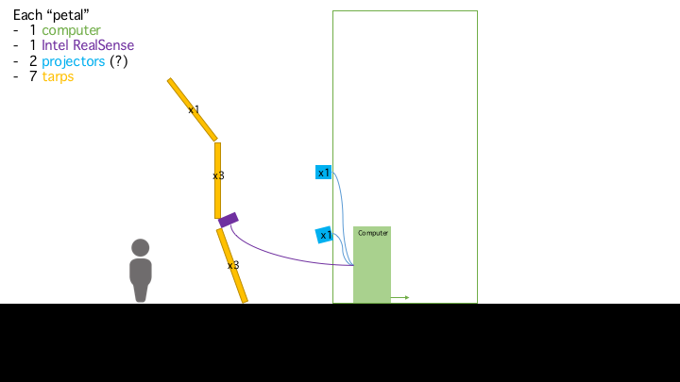

Slide 17
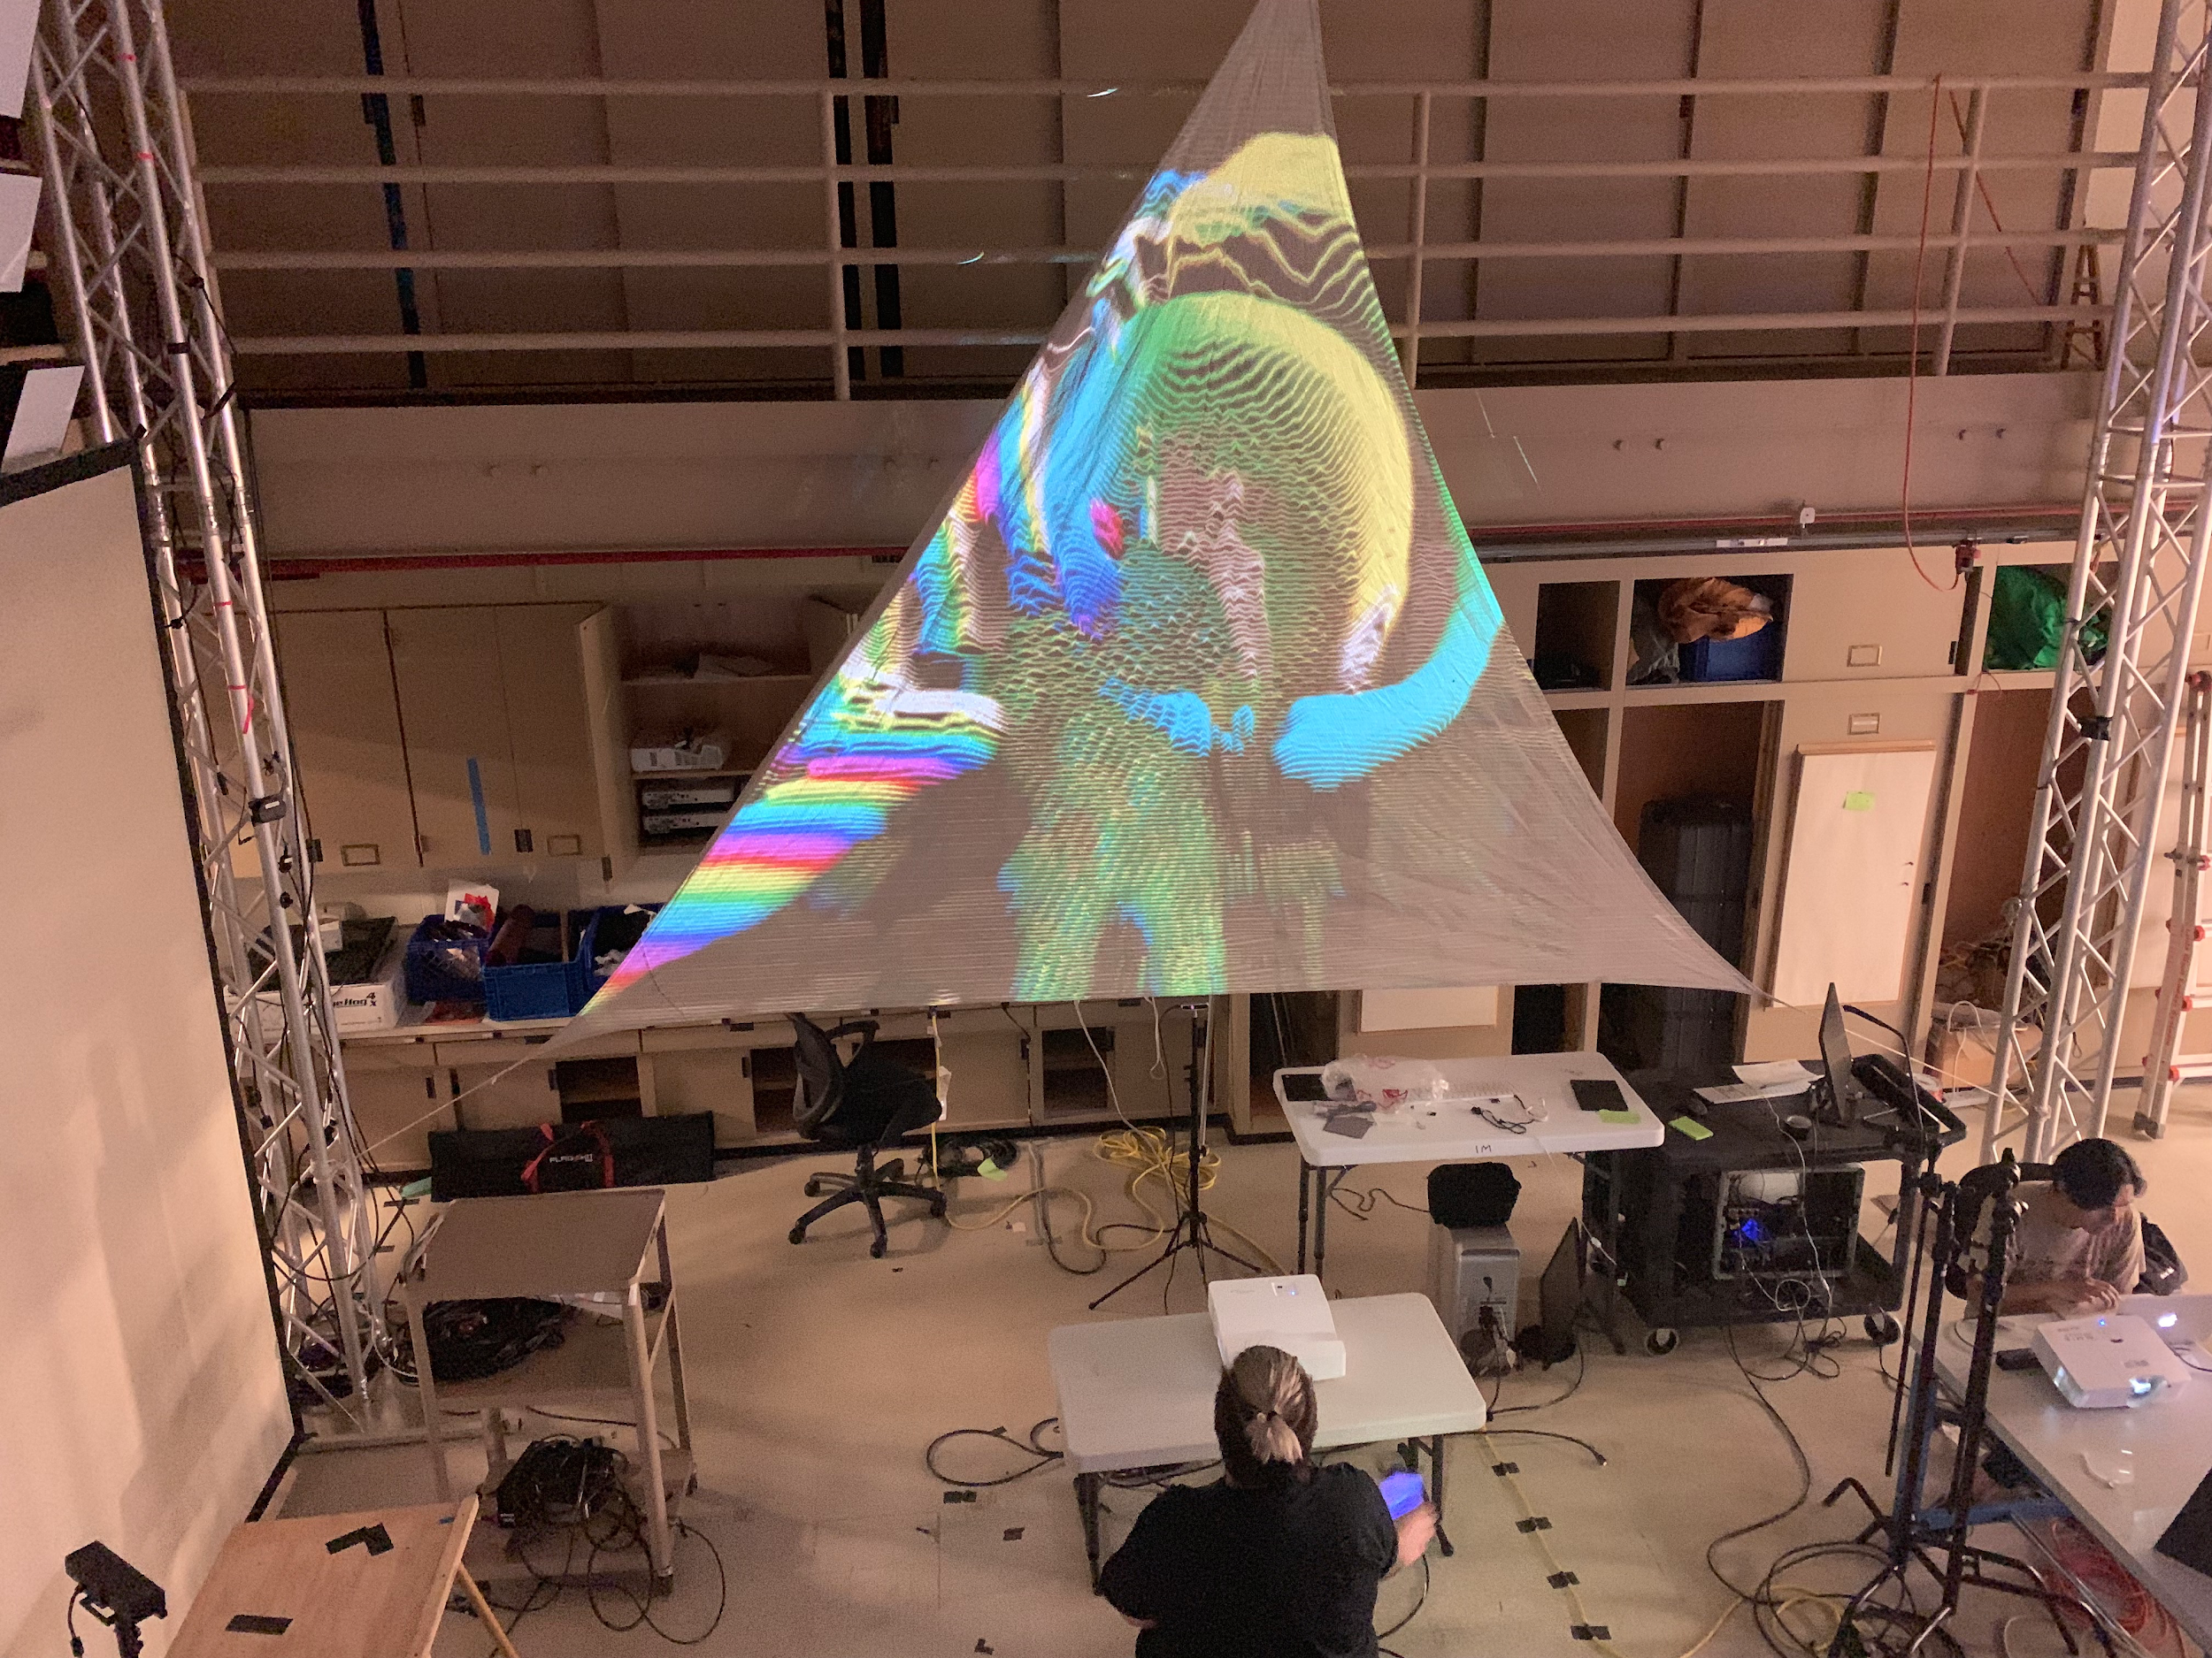
Proof of Concept

Slide 18
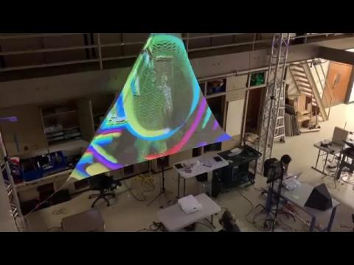

Slide 19
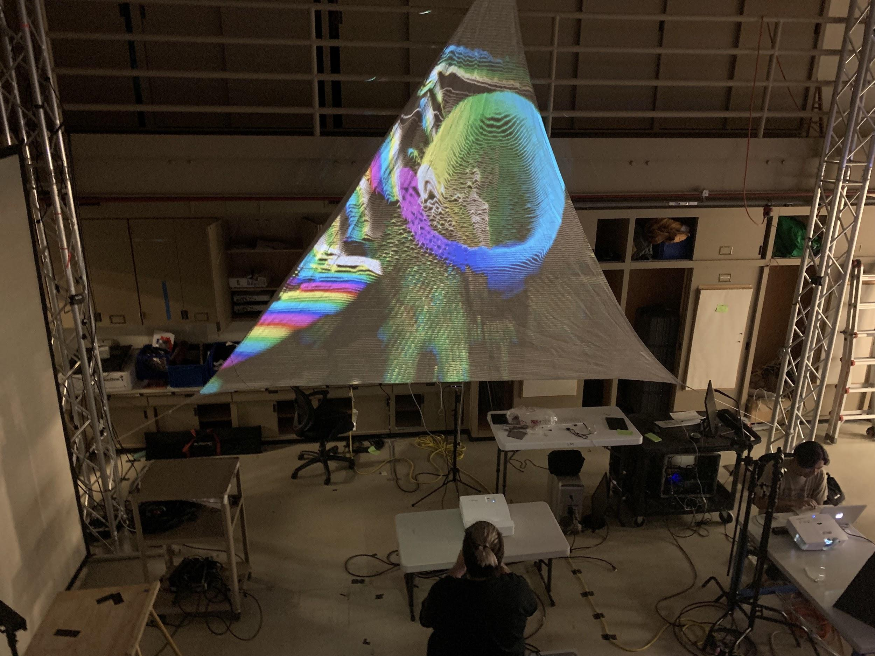

Slide 20
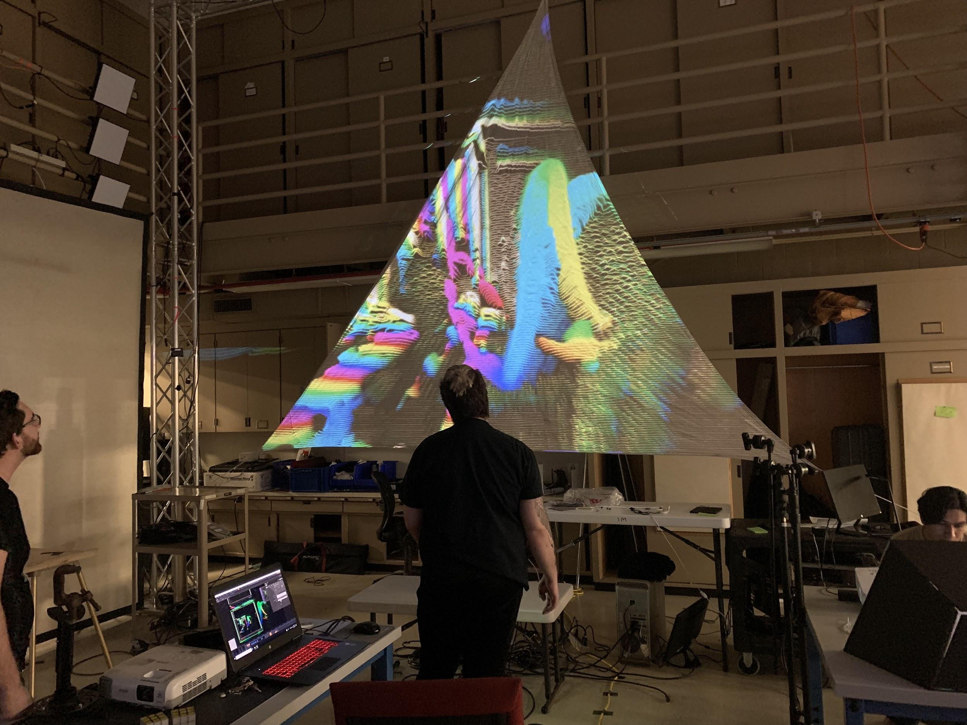

Slide 21
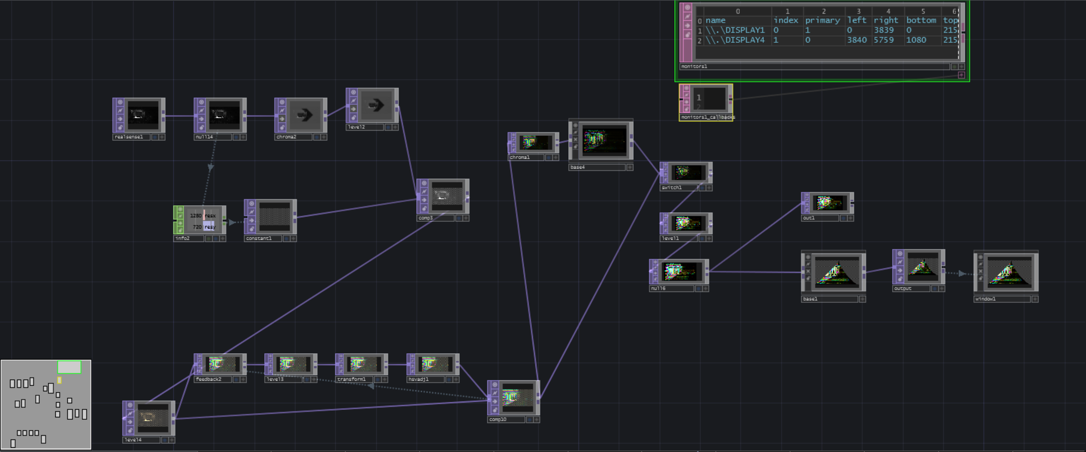
TouchDesigner Network

Slide 22
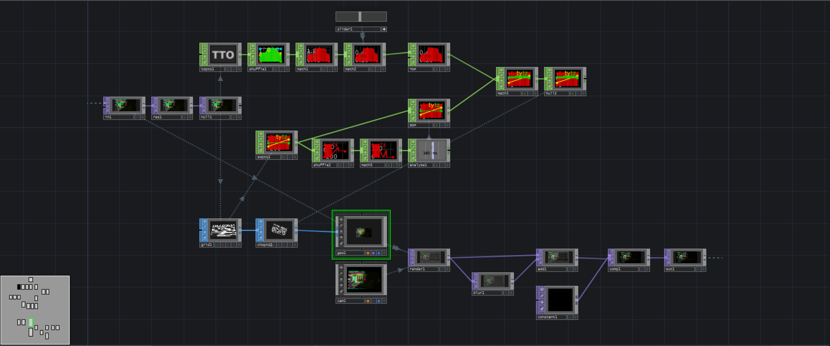
TouchDesigner Network

